Slide 1
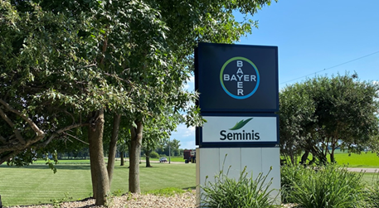
2021 LSRB Intern Project​ -POC for high throughput phenotypic trait ​
Veg R&D Presentations
Aug 19th
Maggie Zhu
Vegetable Breeding R&D Intern

Slide 2
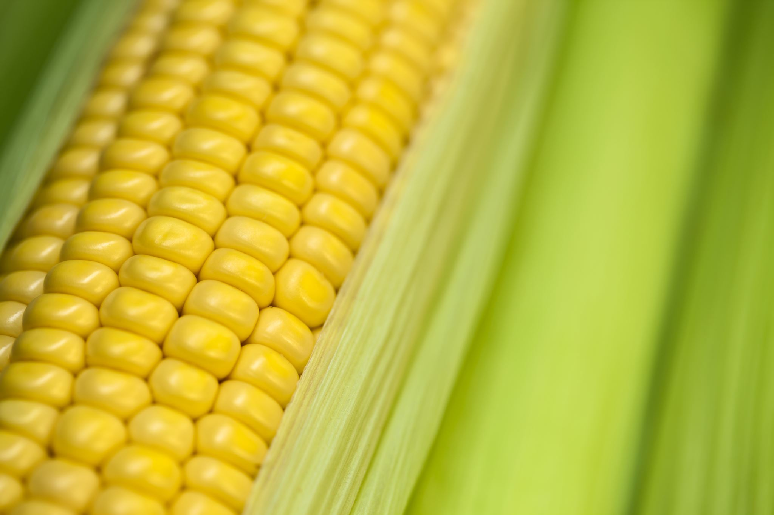

Sweet Corn Breeding Pipeline at a glance
5 Breeders
3 Locations
2 Climates
// Temperate
// Tropical
2 Segments
//Fresh Market
//Processor Market
We seek to deliver best varieties that meet the need of grower, costumers, and consumers.

Slide 3

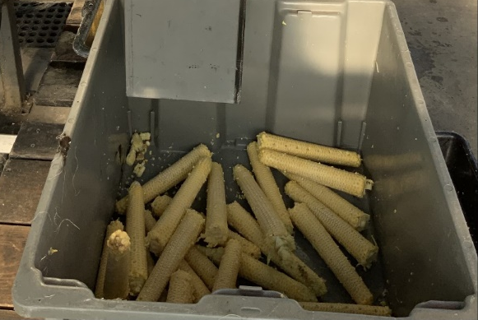
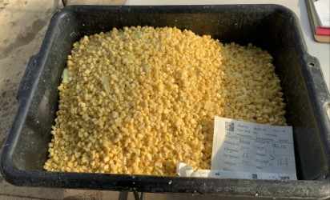
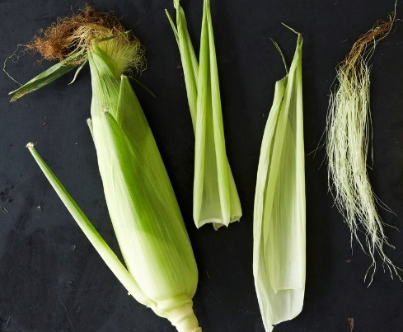
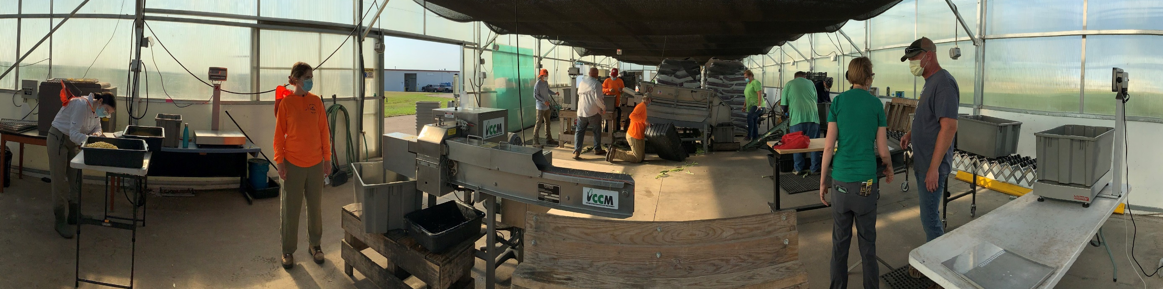

Sweet Corn Processor Market
Cob
Kernels
Leaves and shank
Percent Recovery=$\frac{kernel mass}{whole ear mass before husking}$

Slide 4
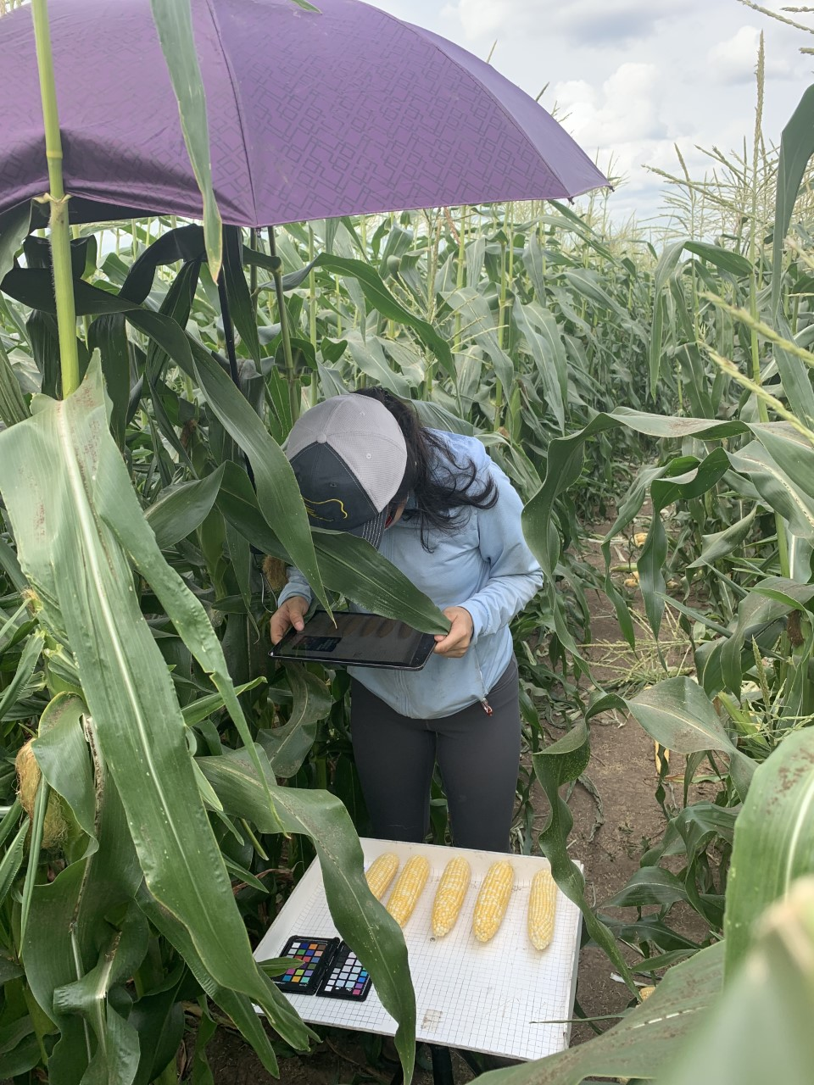



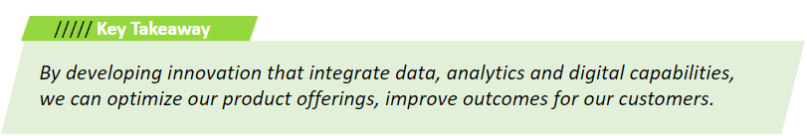
High throughput phenotyping transform our pipeline
Improving product performance and focusing on operational efficiency
Solutions:
Characterize a key trait that represent percent recovery
Converting labor-intensive phenotyping to low-cost image-based phenotyping
Enable selection for percent recovery early in the pipeline
Better seeds with every generation

Slide 5
Ideal state: 2X phenotyping with representative phenotype for most important Processor Market
Current data collection at eating/processing stage
Stage & Pipeline Size
No phenotype
Screening 1
Screening2
PCM3
PCM1
PCM2
Maximum diversity & ideal for Genomic Selection training
Limited homesite
Homesite
Multi-location and reps
Notes:
Name goals, tie to POCs, tied to project plans, tied to outcomes

Slide 6
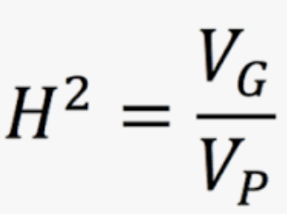
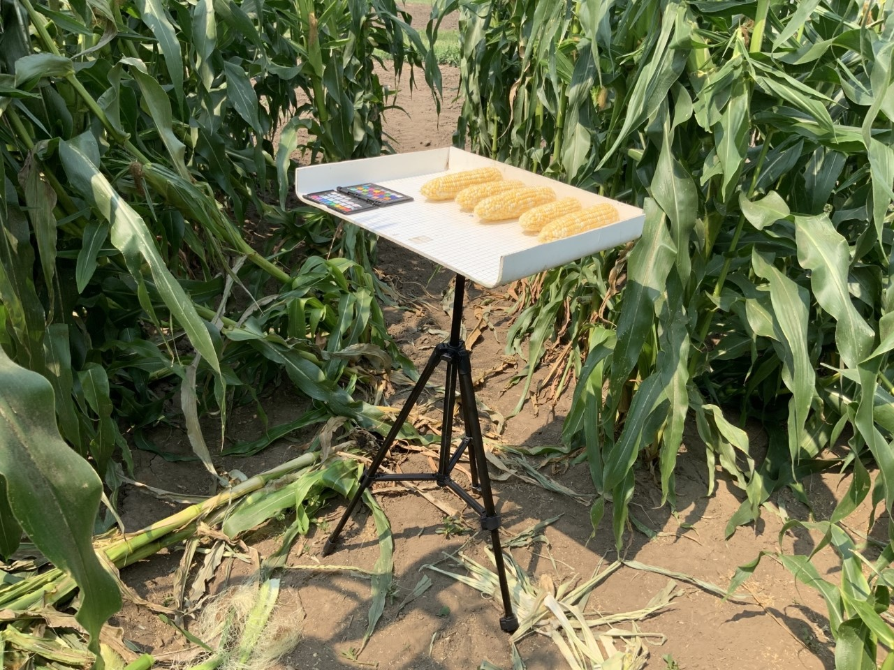
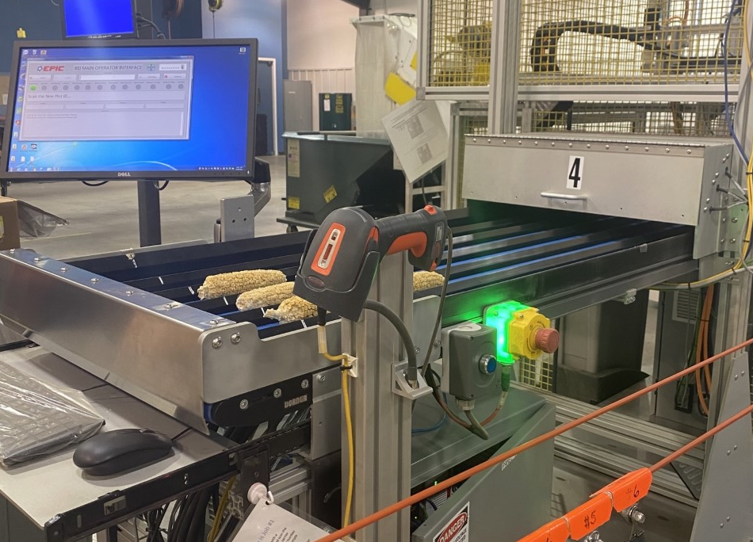

Project plan road map
What is the heritability of: % Recovery, % Cut Kernel, % Green Weight
Will % Cut Kernel or % Green Weight result in a more aggressive response to selection?
What is the relationship between cut cob Ear Length, Diameter, and kernel depth at eating stage?
New Approach
What is the relationship between cut cob Ear Length, Diameter, and kernel depth and additional traits at dry stage?
Traditional way:
Current process to collect % Recovery and foundational traits (% cut kernel and % green weight)

Slide 7
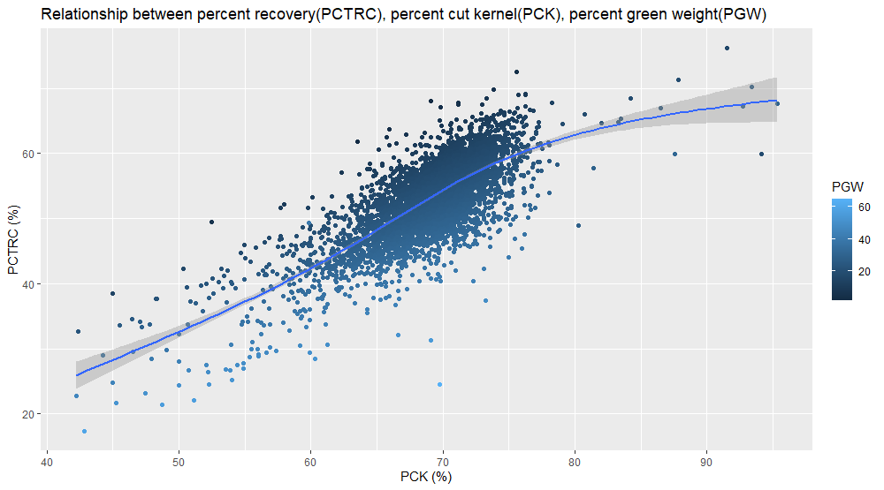
Relationships between three key traits

Slide 8


Heritability(%) estimation on entry-mean basis (Temperate)
 | Recovery | Percent cut kernel | Percent green weigh | Percent cob weigh
Genetic variances | 6.4 | 2.5 | 7.2 | 1.9
Environmental variances | 3.0 | 2.5 | 3.0 | 0.5
G*E | 0.9 | 0.7 | 1.6 | 0.7
E*R*S | 10.9 | 2.4 | 16.9 | 1.9
Residual | 18.3 | 11.3 | 17.4 | 10.2
h2 | 34% | 44% | 28% | 33%
Notes:
Phenotypes that vary between the individuals in a population do so because of both environmental factors and the genes that influence traits, as well as various interactions between genes and environmental factors. We recognize that genetic and/or environmental variation exists, and want to assess them through heritability estimation. heritability is formally defined as the proportion of phenotypic variation (VP) that is due to variation in genetic values (VG). high heritability value of 0.5 means that on average half of the difference among phenotype of this trait are genetic. High var-E indicates the importance of environment in the genetic material studied here. Significance of genetic × environment variances, especially for PCK and pctrc, indicated the need to evaluate these interactions in multiple environments which are representative of the area in which the genotypes are to be grown. PGW showed high heritability value of 0.5. Pctrc percent cut kernel and percent cob weigh showed moderate heritability value.

Slide 9
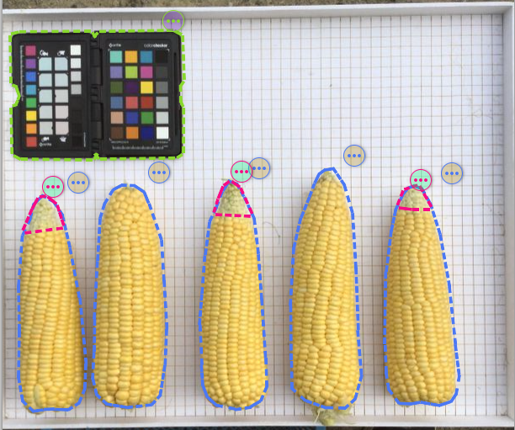
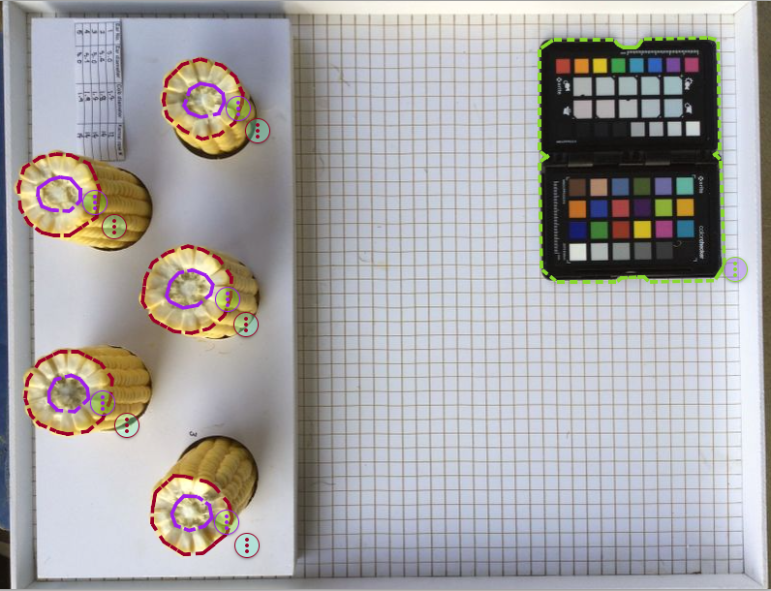
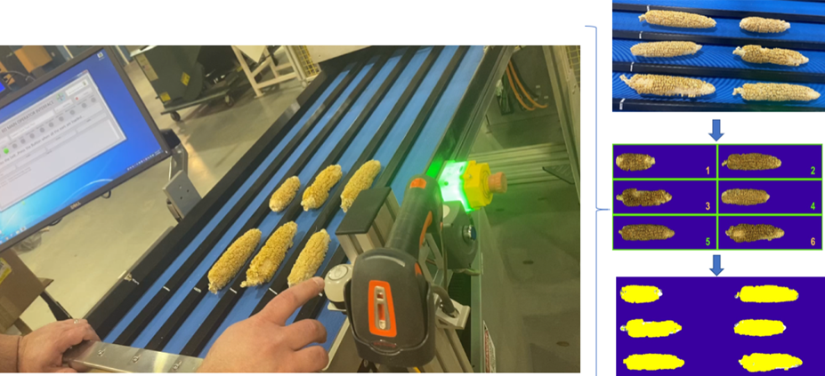
Digitally transforming our operations
1. Ear sideways 2. Ear cross-sections
Example 1: Velocity Image Analysis
Target traits(Eating stage):
Kernel depth
Ear width,
Cob diameter,
Example 2: Huxley Imager
Target traits (Dry down stage):
Kernel depth
Ear width,
Cob diameter,

Slide 10
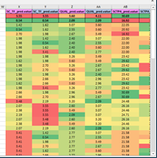
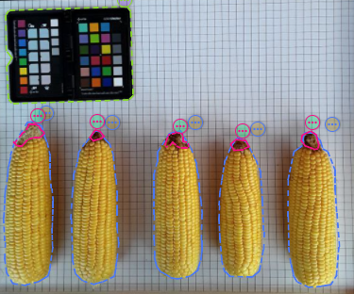
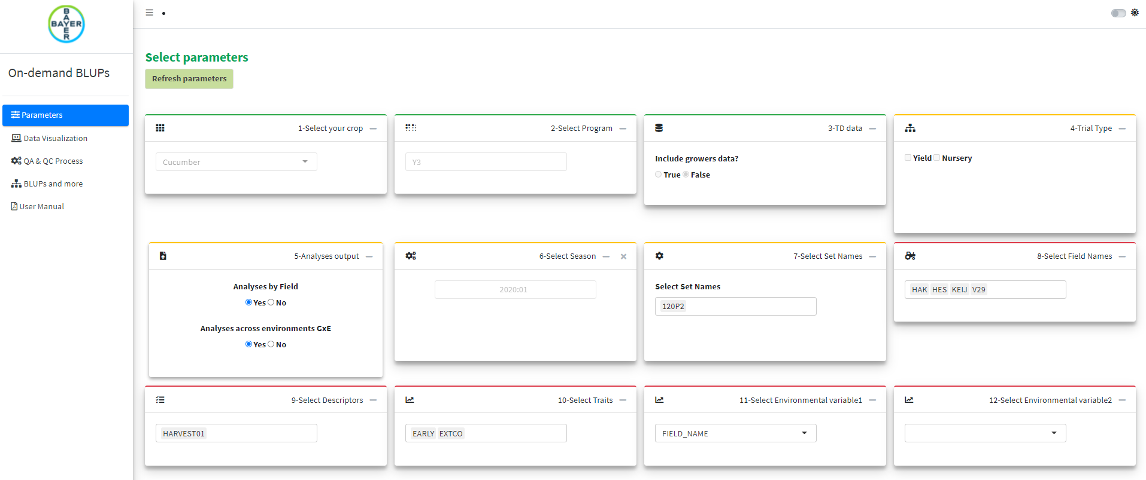
Impact
GWS predictive model
High throughput data collection
Velocity Image Analysis
Prediction
BLUP
Notes:
If a relationship can be identified and a workflow built to capture the data, the following pipeline transformation efforts will be impacted:

Slide 11
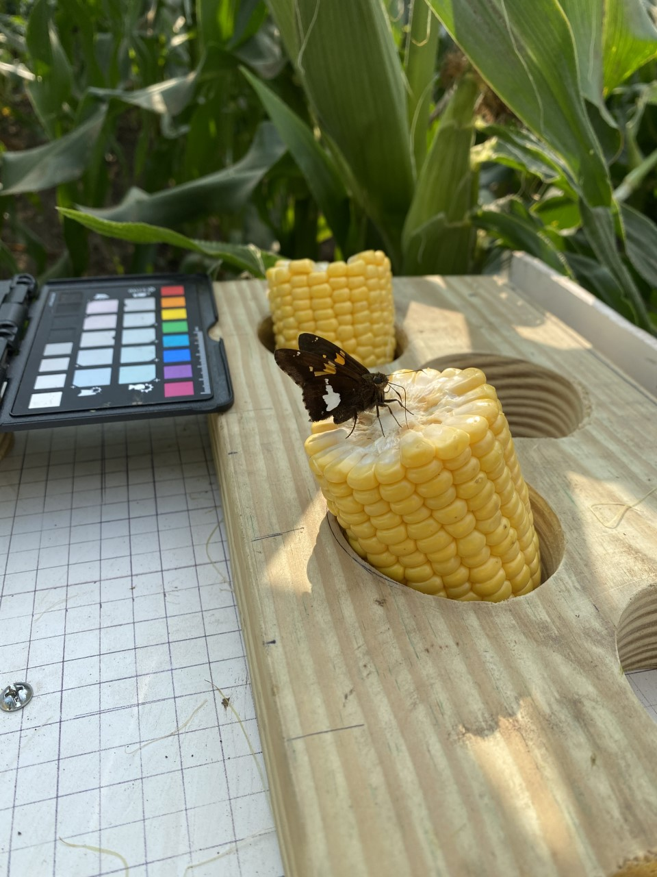
The benefit
We are leveraging technology to refine our internal operations, which in turn inspires greater innovation, faster-delivered products, increased sustainability and improved results for our customers.

Slide 12
One Team
Breeding
Sarah Braun (DeForest/WI, USA – Line Temperate Sweet Corn Breeder)
Mariana Niederheitmann (Uberlândia/MG, Brazil - Breeding Scientist)
Jennifer Jacobs (Chesterfield/MI, USA – America´s Breeding Lead – Large Seed, Root, and Bulb)
Kyle Parmley (Woodland/CA- Breeding mentor)
Analytics and Pipeline Design
Chad Jorgensen (Woodland/CA, USA – Experiments and Trials Digital Specialist – Analysis and Decisions)
Barret Page (Deforest/WI,USA - Pipeline Enablement East)
Zach Njus (Huxley/IA, USA- Agronomy Research Specialist-Seed production System)

